Slide 1
Poetry and Lyrics
101 continued

Slide 2
S. E. E – one paragraph answers
S = Statement
E = Example
E = Elaboration

Slide 3
Statement
Topic or key sentence
Answers the question
Uses language from the question
Establishes the topic of the paragraph

Slide 4
Example
Evidence
Gives you authority
A quote from the text
Description from the text
Referenced: ie. in stanza 3 line 5 alliteration is used…
There can be more than one example

Slide 5
Elaboration
Explaining why?
You now link why the example you gave provides the answer you stated in your statement
If you used more than one example you should refer to both examples in your elaboration

Slide 6
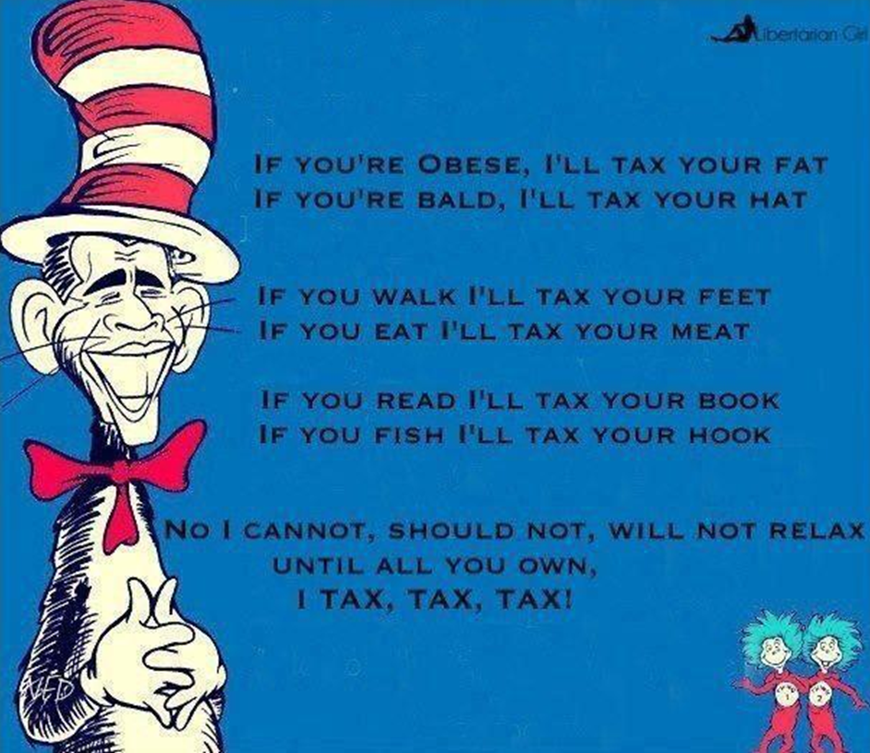
How to use S. E. E.
How has intertextuality been
used within the text?

Slide 7
How has intertextuality been used within the text?
Intertextuality can be observed through the use of rhyme and metre within the text and has been used to aid satirical humour. The poet has used a aa, bb, cc, d, e, d rhyming scheme as also seen in Dr Seuss’s Green Eggs and Ham. The poet has also mimicked Dr Seuss in his use of metre to add a familiar rhythmic musicality to his poem. Here, therefore, intertextuality has aided satirical humour as the poet has used an “American icon”, Dr Seuss, to make fun of, Obama, another “American icon”.

Slide 8
How has intertextuality been used within the text?
Intertextuality can be observed through the use of rhyme and metre within the text and has been used to aid satirical humour. The poet has used a aa, bb, cc, d, e, d rhyming scheme as also seen in Dr Seuss’s Green Eggs and Ham. The poet has also mimicked Dr Seuss in his use of metre to add a familiar rhythmic musicality to his poem. Here, therefore, intertextuality has aided satirical humour as the poet has used an “American icon”, Dr Seuss, to make fun of, Obama, another “American icon”.

Slide 9
How has intertextuality been used within the text?
Intertextuality can be observed through the use of rhyme and metre within the text and has been used to aid satirical humour. The poet has used a aa, bb, cc, d, e, d rhyming scheme as also seen in Dr Seuss’s Green Eggs and Ham. The poet has also mimicked Dr Seuss in his use of metre to add a familiar rhythmic musicality to his poem. Here, therefore, intertextuality has aided satirical humour as the poet has used an “American icon”, Dr Seuss, to make fun of, Obama, another “American icon”.

Slide 10
How has intertextuality been used within the text?
Intertextuality can be observed through the use of rhyme and metre within the text and has been used to aid satirical humour. The poet has used a aa, bb, cc, d, e, d rhyming scheme as also seen in Dr Seuss’s Green Eggs and Ham. The poet has also mimicked Dr Seuss in his use of metre to add a familiar rhythmic musicality to his poem. Here, therefore, intertextuality has aided satirical humour as the poet has used an “American icon”, Dr Seuss, to make fun of, Obama, another “American icon”.

Slide 11
How has intertextuality been used within the text?
Intertextuality can be observed through the use of rhyme and metre within the text and has been used to aid satirical humour. The poet has used a aa, bb, cc, d, e, d rhyming scheme as also seen in Dr Seuss’s Green Eggs and Ham. The poet has also mimicked Dr Seuss in his use of metre to add a familiar rhythmic musicality to his poem. Here, therefore, intertextuality has aided satirical humour as the poet has used an “American icon”, Dr Seuss, to make fun of, Obama, another “American icon”.

Slide 12
How has intertextuality been used within the text?
Intertextuality can be observed through the use of rhyme and metre within the text and has been used to aid satirical humour. The poet has used a aa, bb, cc, d, e, d rhyming scheme as also seen in Dr Seuss’s Green Eggs and Ham. The poet has also mimicked Dr Seuss in his use of metre to add a familiar rhythmic musicality to his poem. Here, therefore, intertextuality has aided satirical humour as the poet has used an “American icon”, Dr Seuss, to make fun of, Obama, another “American icon”.

Slide 13
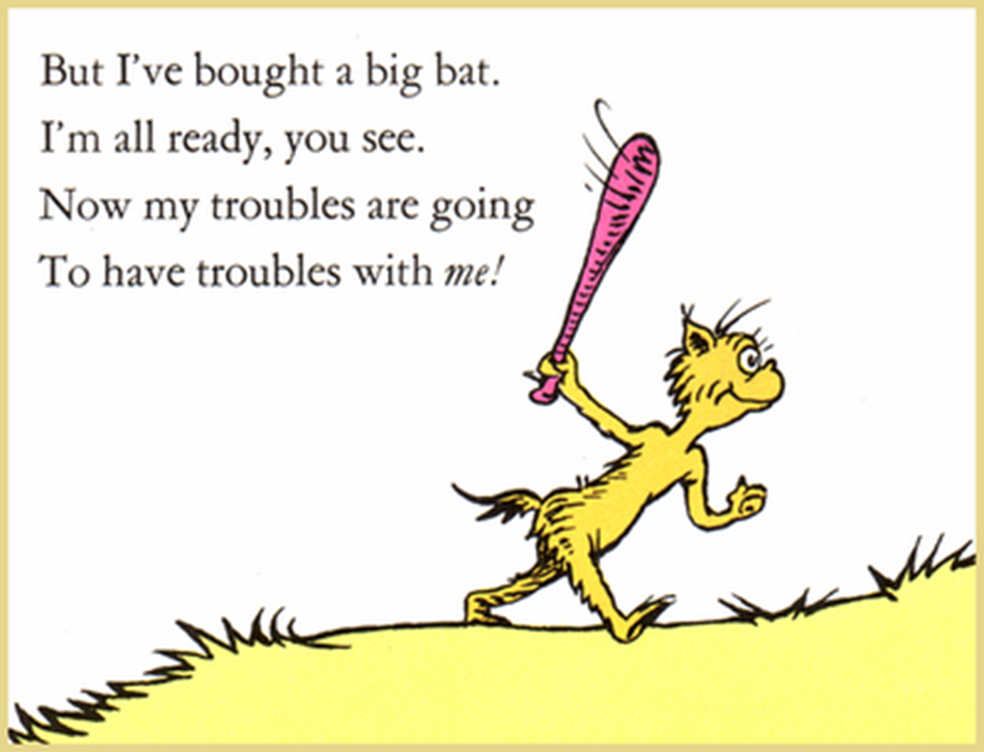
Now you try…
In what ways has Dr Seuss used alliteration in the stanza below?

Slide 14
Poetry and Lyrics
101 continued

Slide 15
S. E. E – one paragraph answers
S = Statement
E = Example
E = Elaboration

Slide 16
How has intertextuality been used within the text?
Intertextuality can be observed through the use of rhyme and metre within the text and has been used to aid satirical humour. The poet has used a aa, bb, cc, d, e, d rhyming scheme as also seen in Dr Seuss’s Green Eggs and Ham. The poet has also mimicked Dr Seuss in his use of metre to add a familiar rhythmic musicality to his poem. Here, therefore, intertextuality has aided satirical humour as the poet has used an “American icon”, Dr Seuss, to make fun of, Obama, another “American icon”.

Slide 17
Another example…
How is “relationships”, as a theme, established within Brother by Matt Corby?
Matt Corby establishes “relationships” early in the lyrics of Brother using metaphor. The first line of the first stanza states “sleep now under my skin”. The use of this metaphor creates, for the listener or reader, an image of discomfort. This metaphor suggests that a key theme within the lyrics will concern a repressive relationship. The suggestion that the relationship is “under my skin” illustrates that the relationship is one which the narrator finds uncomfortable and even repressive. Matt Corby reinforces the use of metaphor in the first line by continuing with further metaphor in the third and fourth lines of the first stanza. Corby suggests that his “brother” can “conjure the wind” to “ease my mind”. The conjuring of the wind is a metaphor for manipulation and therefore these lines suggest that the “brother” is able to ease discomfort with manipulation. This supports the establishment of a repressive relationship within the lyrics.

Slide 18
Another example…
How is “relationships”, as a theme, established within Brother by Matt Corby?
Matt Corby establishes “relationships” early in the lyrics of Brother using metaphor. The first line of the first stanza states “sleep now under my skin”. The use of this metaphor creates, for the listener or reader, an image of discomfort. This metaphor suggests that a key theme within the lyrics will concern a repressive relationship. The suggestion that the relationship is “under my skin” illustrates that the relationship is one which the narrator finds uncomfortable and even repressive. Matt Corby reinforces the use of metaphor in the first line by continuing with further metaphor in the third and fourth lines of the first stanza. Corby suggests that his “brother” can “conjure the wind” to “ease my mind”. The conjuring of the wind is a metaphor for manipulation and therefore these lines suggest that the “brother” is able to ease discomfort with manipulation. This supports the establishment of a repressive relationship within the lyrics.

Slide 19
The T.E.E.L. structure
TOPIC SENTENCE
EXAMPLE
EXPLAIN
LINK
T
For answers with more than one paragraph
E
E
L

Slide 20
LINK
This is a linking sentence
This sentence has two roles:
1. It links back to the question by using language from the question
2. It links the current paragraph to the next paragraph

Slide 21
How to use T.E.E.L
How has intertextuality been
used within the text?

Slide 22
How has intertextuality and symbolism been used within the text?
Intertextuality can be observed through the use of rhyme and metre within the text and has been used to aid satirical humour. The poet has used a aa, bb, cc, d, e, d rhyming scheme as also seen in Dr Seuss’s Green Eggs and Ham. The poet has also mimicked Dr Seuss in his use of metre to add a familiar rhythmic musicality to his poem. Here, therefore, intertextuality has aided satirical humour as the poet has used an “American icon”, Dr Seuss, to make fun of, Obama, another “American icon”. Intertextuality has been used within the text to aid satirical humour as has symbolism.

Slide 23
How has intertextuality and symbolism been used within the text?
Intertextuality can be observed through the use of rhyme and metre within the text and has been used to aid satirical humour. The poet has used a aa, bb, cc, d, e, d rhyming scheme as also seen in Dr Seuss’s Green Eggs and Ham. The poet has also mimicked Dr Seuss in his use of metre to add a familiar rhythmic musicality to his poem. Here, therefore, intertextuality has aided satirical humour as the poet has used an “American icon”, Dr Seuss, to make fun of, Obama, another “American icon”. Intertextuality has been used within the text to aid satirical humour as has symbolism.

Slide 24
How has intertextuality and symbolism been used within the text?
Intertextuality can be observed through the use of rhyme and metre within the text and has been used to aid satirical humour. The poet has used a aa, bb, cc, d, e, d rhyming scheme as also seen in Dr Seuss’s Green Eggs and Ham. The poet has also mimicked Dr Seuss in his use of metre to add a familiar rhythmic musicality to his poem. Here, therefore, intertextuality has aided satirical humour as the poet has used an “American icon”, Dr Seuss, to make fun of, Obama, another “American icon”. Intertextuality has been used within the text to aid satirical humour as has symbolism.

Slide 25
How has intertextuality and symbolism been used within the text?
Intertextuality can be observed through the use of rhyme and metre within the text and has been used to aid satirical humour. The poet has used a aa, bb, cc, d, e, d rhyming scheme as also seen in Dr Seuss’s Green Eggs and Ham. The poet has also mimicked Dr Seuss in his use of metre to add a familiar rhythmic musicality to his poem. Here, therefore, intertextuality has aided satirical humour as the poet has used an “American icon”, Dr Seuss, to make fun of, Obama, another “American icon”. Intertextuality has been used within the text to aid satirical humour as has symbolism.

Slide 26
How has intertextuality and symbolism been used within the text?
Intertextuality can be observed through the use of rhyme and metre within the text and has been used to aid satirical humour. The poet has used a aa, bb, cc, d, e, d rhyming scheme as also seen in Dr Seuss’s Green Eggs and Ham. The poet has also mimicked Dr Seuss in his use of metre to add a familiar rhythmic musicality to his poem. Here, therefore, intertextuality has aided satirical humour as the poet has used an “American icon”, Dr Seuss, to make fun of, Obama, another “American icon”. Intertextuality has been used within the text to aid satirical humour as has symbolism.

Slide 27
Now you try…
How is “relationships”, as a theme, established within Brother by Matt Corby?
Matt Corby establishes “relationships” early in the lyrics of Brother using metaphor. The first line of the first stanza states “sleep now under my skin”. The use of this metaphor creates, for the listener or reader, an image of discomfort. This metaphor suggests that a key theme within the lyrics will concern a repressive relationship. The suggestion that the relationship is “under my skin” illustrates that the relationship is one which the narrator finds uncomfortable and even repressive. Matt Corby reinforces the use of metaphor in the first line by continuing with further metaphor in the third and fourth lines of the first stanza. Corby suggests that his “brother” can “conjure the wind” to “ease my mind”. The conjuring of the wind is a metaphor for manipulation and therefore these lines suggest that the “brother” is able to ease discomfort with manipulation. This supports the establishment of a repressive relationship within the lyrics.

Slide 28
Now you try…
How is “relationships”, as a theme, established within Brother by Matt Corby?
Matt Corby establishes “relationships” early in the lyrics of Brother using metaphor. The first line of the first stanza states “sleep now under my skin”. The use of this metaphor creates, for the listener or reader, an image of discomfort. This metaphor suggests that a key theme within the lyrics will concern a repressive relationship. The suggestion that the relationship is “under my skin” illustrates that the relationship is one which the narrator finds uncomfortable and even repressive. Matt Corby reinforces the use of metaphor in the first line by continuing with further metaphor in the third and fourth lines of the first stanza. Corby suggests that his “brother” can “conjure the wind” to “ease my mind”. The conjuring of the wind is a metaphor for manipulation and therefore these lines suggest that the “brother” is able to ease discomfort with manipulation. This supports the establishment of a repressive relationship within the lyrics.
Linking Sentence…

