Slide 1
Poetry and Lyrics
Poetic Devices 101

Slide 2
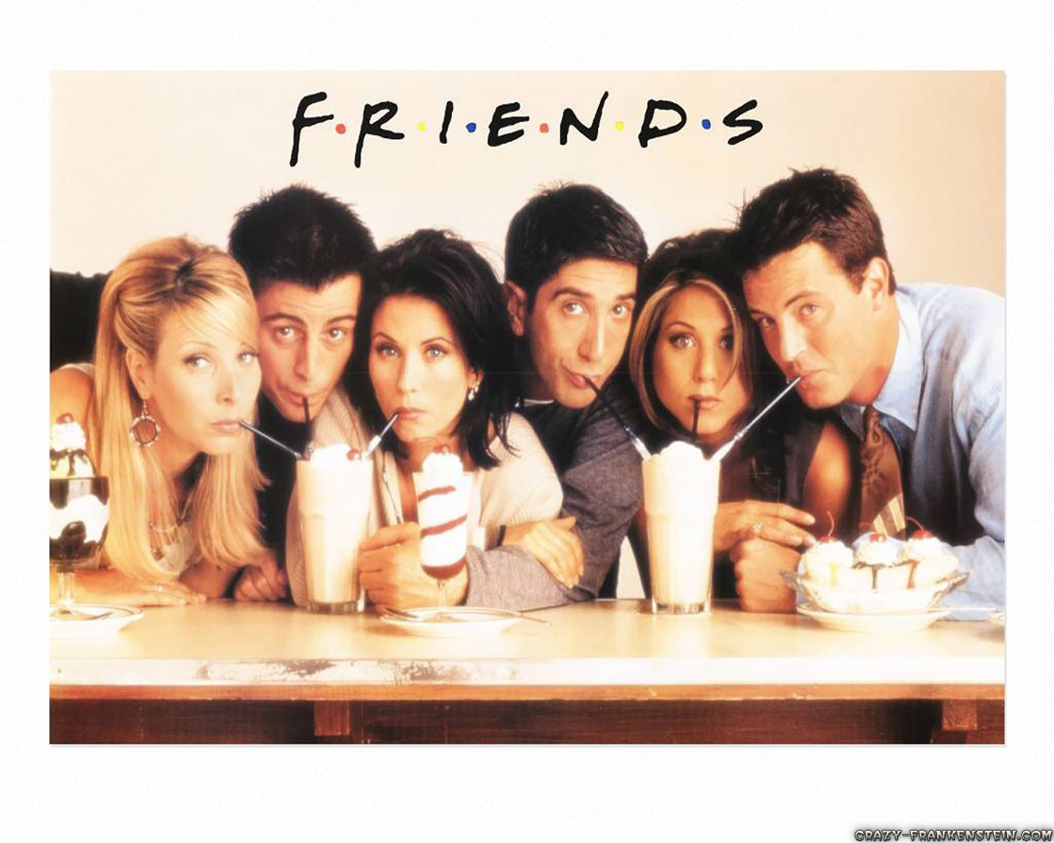
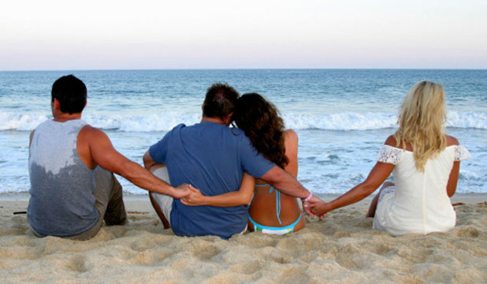
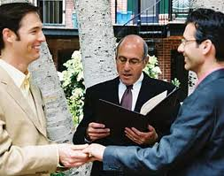
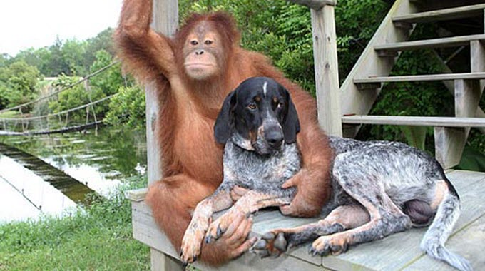
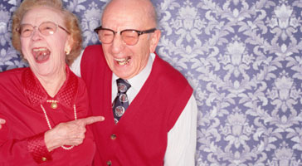
Why is it important to write texts which deal with ‘relationship’ themes?

Slide 3
Rhyme
A rhyme is a repetition of similar sounding words occurring at the end of lines in poems or songs.
Repeating patterns that bring rhythm or musicality to poems
Differentiate poetry from prose which is plain
A mnemonic device smoothing the progress of memorization
For instance, all nursery rhymes contain rhyming words in order to facilitate learning for children.

Slide 4
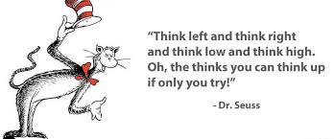
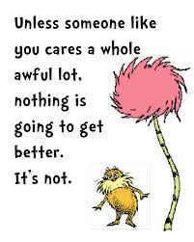
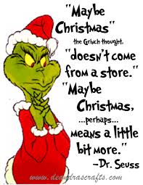

Slide 5
Metre
Metre is a stressed and unstressed syllabic pattern in a verse or within the lines of a poem.
Stressed syllables tend to be longer and unstressed shorter
We mark them with an - for long and a x for short
It gives poetry a rhythmical and melodious sound
For instance, if you read a poem loudly, and it produces regular sound patterns, then this poem would be a metered or measured poem

Slide 6
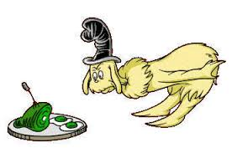

Slide 7
Metaphor
A metaphor is a word or phrase that is used to make a comparison between two things.
Aids imagery
Aid themes and ideas
What is a simile?
Simile is a literary device that is used to make a comparison. While very similar to a metaphor, a simile is different because it uses the words “like” or “as” to make a comparison.

Slide 8
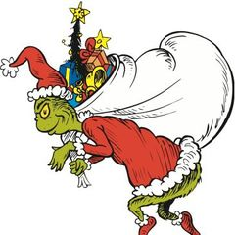
You're a mean one, Mr. Grinch.
You really are a heel.
You're as cuddly as a cactus,
You're as charming as an eel,
Mr. Grinch.
You're a bad banana with a greasy black peel.

Slide 9
Adele “Turning Tables”
Close enough to start a war,
All that I have is on the floor,
God only knows what we're fighting for,
All that I say, you always say more,
I can't keep up with your turning tables,
Under your thumb, I can't breathe,

Slide 10
So I won't let you close enough to hurt me,
No, I won't ask you, you to just desert me,
I can't give you what you think you gave me,
It's time to say goodbye to turning tables,
To turning tables,

Slide 11
Under haunted skies I see, ooh,
Where love is lost, your ghost is found,
I braved a hundred storms to leave you,
As hard as you try, no, I will never be knocked down,
I can't keep up with your turning tables,
Under your thumb, I can't breathe,

Slide 12
So I won't let you close enough to hurt me,
No, I won't ask you, you to just desert me,
I can't give you what you think you gave me,
It's time to say goodbye to turning tables,
Turning tables,

Slide 13
Next time I'll be braver,
I'll be my own savior,
When the thunder calls for me,
Next time I'll be braver,
I'll be my own savior,
Standing on my own two feet,

Slide 14
I won't let you close enough to hurt me,
No, I won't ask you, you to just desert me,
I can't give you what you think you gave me,
It's time to say goodbye to turning tables,
To turning tables,
Turning tables, yeah,
Turning, oh.

Slide 15
Poetry and Lyrics
101 continued…

Slide 16
Repetition
Repetition is a literary device that repeats the same words or phrases a few times to make an idea clearer.
Supports Rhyme and Metre.
Is similar to Alliteration.
Alliteration is characterized by a number of words, typically three or more, that have the same first consonant sound fall within the same sentence or phrase.

Slide 17
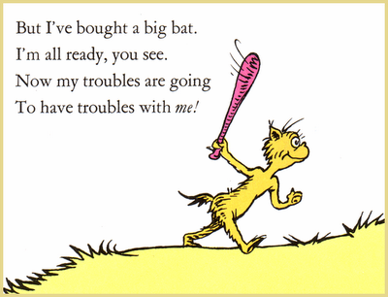

Slide 18
Symbolism
A symbol in literature is anything (truly, ANYTHING!) that stands for something else.
Relates to metaphor and simile
Hozier “Take me to church”
Take me to church
I'll worship like a dog at the shrine of your lies
I'll tell you my sins and you can sharpen your knife
Offer me that deathless death
Good God, let me give you my life

Slide 19
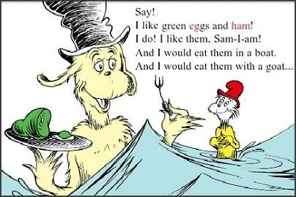

Slide 20
Tone
Tone, in written composition, is an attitude of a writer toward a subject or an audience. Tone is generally conveyed through the choice of words or the viewpoint of a writer on a particular subject.
Can also be called mood
Choice of vocabulary
Use of Punctuation
Links to Repetition, Alliteration, Rhyme and metre
Read it out loud

Slide 21
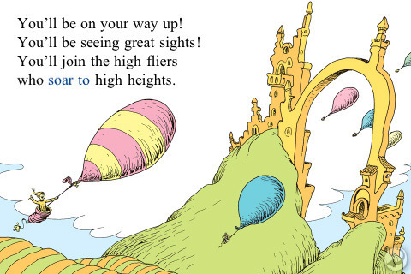

Slide 22
Intertextuality
Is a textual reference within some text that reflects another text. Instead simply referencing phrases from different texts, intertextuality draws upon concept, rhetoric or ideology from other texts.
The retelling of an old story
The modernisation of an old text
The use of or a commentary of an idea from another text

Slide 23
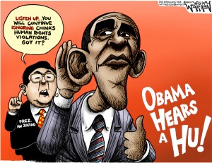
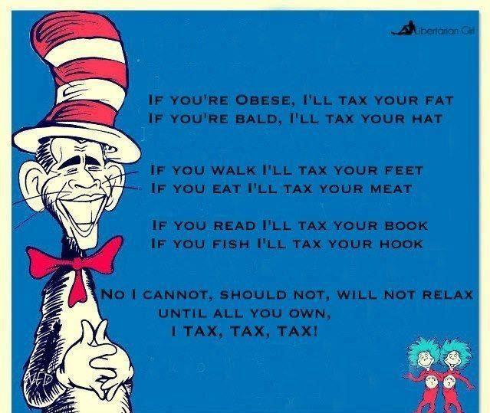

Slide 24
Meg Mac “Grandma’s Hands”
Word Tally - counting the use of common words.
In your partners discuss why? What does it link to?

Slide 25
Macklemore “Same Love”
What is he saying about homosexuality in each stanza?
How does he say it?
How has he used intertextuality to enhance that...?

Slide 26
Hozier “Take me to Church”
Individual task:
You are to complete closed reading of Hozier’s “Take me to Church”.
Look for repetition, symbolism, intertextuality, tone, metre, rhyme, similes and metaphor.

