Slide 1
Planning your story
and getting started…

Slide 2
Reading “The Lottery” by Shirley Jackson

Slide 3
The conventional plot shape…
Beginning Climax End
This is what we recognise from primary school. It is illustrated in orange.

Slide 4
The captivating plot shape…
Hook – captures the audiences attention.
Backfill – catches the audience up and sets the scene.
Tension pebble – a small event or scenario that creates a dilemma.
Building brick – something that extends that dilemma.
Tension boulder – everything seems impossible.
Climax – a light appears at the end of the tunnel but it could go eithers way.
Wrap – resolution = it all becomes obvious but the threat doesn’t disappear.

Slide 5
Planning essentials…
Setting
Characters – protagonist/antagonist?
Sub-genre… themes… motifs…
Types of sensory language – vocab
Now you plan your story…

Slide 6
Your “hook”…
Using action, onomatopoeia or dialogue to capture the audiences attention!
What does onomatopoeia mean? Look it up…
How has “The Lottery” by Shirley Jackson done this?
Now write your own hook…

Slide 7
Backfill…
Backfilling catches the audience up and it sets the scene. It makes them feel safe and secure. The tension in the “hook” is immediately resolved, for now…
Show don’t tell… use short sentence, use sensory language, use imagery…
No boring bits… don’t just describe!
How has “The Lottery” backfilled? Why? Was it effective? How can we make ours shorter? – we only have 800 words.

Slide 8
Adding pebbles of tension…
Now you revisit the tension created during your “hook”.
EXAMPLE
During your “hook”: perhaps the phone rang and someone hung up...! Then it was ok because it turned out it was your friend but they just got cut off.
Now the phone rings and it hangs up… then it rings again and you hear heavy breathing…!

Slide 9
Building bricks… and BOULDERS of tension!!!
This is your next step you need to build your tension toward a boulder where everything seems impossible.
build your tension using sensory language: what does your protagonist see, hear, smell, taste, touch, and feel (emotion)?
Use varied language.
Use dialogue.
Use short sentences – this makes it thrilling – it is like the use of quick shots of quickening music in film = it makes the reader feel unstable.

Slide 10
Your Climax
There is finally a light at the end of the tunnel but it could go either way.
This is your quickest section: short sentences, sensory language, dialogue!
Your climax means that finally the unknown becomes known.

Slide 11
The Wrap
Unlike in a conventional ending all does not become good, you can’t just wake up from a dream.
The threat is still present, you just escaped it, for now…

Slide 12
Practicing vocab... Other ways to say the same word

Slide 13
Good
Acceptable
Excellent
Exceptional
Favorable
Great
Marvelous
Positive
Satisfactory
Satisfying
Superb
Valuable
Wonderful
Ace
Bos
Capital
Choice
Nice
Pleasing
Prime
Rad
Sound
Spanking
Sterling
Super
Superior
Welcome
Worthy
Admirable
Agreeable
Commendable
Congenial
Deluxe
First-class
First-rate
Gnarly
Gratifying
Honorable
Neat
Precious
Rreputable
Select
Shipshape
Splendid
Stupendous
Super-eminent
Super-excellent
Tip-top
Up to snuff

Slide 14
Bad
Disagreeable
Expected
Inferior
Insignificant
OK
Ordinary
Poor
Second-rate
Unacceptable
Unhelpful
Unimportant
Unnoteworthy
Unsatisfactory
Worthless
Minor
Detestable
Evil
Fake
Forged
Immoral
Inadequate
Incompetent
Inconsequential
Inconsiderable
Mean
Misbehaving
Noxious
Rotten
Sinful
Tainted
Unpleasant
Unreal
Unreliable
Unskilled
Unsuitable
Unvirtuous
Vicious
Vile
Wicked

Slide 15
Red
Cardinal
Coral
Crimson
Flaming
Glowing
Maroon
Rose
Wine
Bittersweet
Blooming
Blush
Brick
Burgundy
Carmine
Cherry
Claret
Copper
Garnet
Infrared
Puce
Ruby
Russet
Rust
Salmon
Anguine
Scarlet
Titian
Vermilion
Bloodshot
Florid
Flushed
Healthy
Inflamed
Roseate
Rubicund
Ruddy
Rufescent

Slide 16
Cold
Bitter
Bleak
Brisk
Chilled
Cool
Crisp
Frigid
Frosty
Frozen
Icy
Intense
Raw
Snowy
Wintry
Arctic
Chill
Cutting
Hyperborean
Icebox
Keen
Sharp
Siberian
Stinging
Algid
below freezing
below zero
Benumbed
Biting
Blasting
Boreal
Brumal
Gelid
Glacial
have goose bumps
Hawkish
Hiemal
Iced
Inclement
Nipping
Nippy
Numbed
Numbing
one-dog night
Penetrating
Piercing
Polar
Rimy
Severe
Shivery
Sleety
Snappy
Two-dog night

Slide 17
Frightening
Daunting
Disheartening
Formidable
Rebarbative
Redoubtable
Terrifying
Fearsome
Fearful

Slide 18
Now think of three words that you use all of the time… For each word write three alternate words!

Slide 19
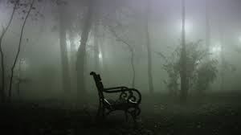
Describe these images… Use one or two words at a time rather that sentences.

Slide 20
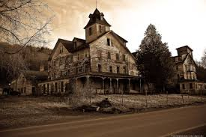
Describe these images… Use one or two words at a time rather that sentences.

Slide 21
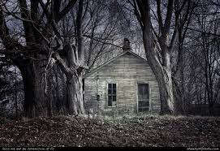
Describe these images… Use one or two words at a time rather that sentences.

Slide 22
How to use dialogue correctly…
We use inverted commas [“…”] surrounding any speech
We keep description on the same line as the speech
When a new person speaks we put a space and start on a new line
We don’t list a name followed by a colon like in plays

Slide 23
How to use dialogue correctly…
And Mr. Summers turned to look at her, "Wife draws for her husband." Mr. Summers said. "Don't you have a grown boy to do it for you, Janey?" Although Mr. Summers and everyone else in the village knew the answer perfectly well, it was the business of the official of the lottery to ask such questions formally. Mr. Summers waited with an expression of polite interest while Mrs. Dunbar answered.
"Horace's not but sixteen vet." Mrs. Dunbar said regretfully. "Guess I gotta fill in for the old man this year."
"Right." Mr. Summers said. He made a note on the list he was holding. Then he asked, "Watson boy drawing this year?" A tall boy in the crowd raised his hand.

Slide 24
Using punctuation for effect…
A comma, a full stop, or an exclamation mark can make all the difference to the meaning conveyed.
In narrative writing be sure to use punctuation for
expression.

Slide 25
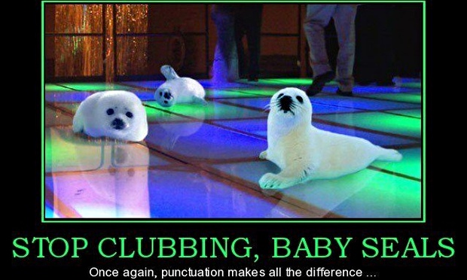
Using punctuation for effect…

Slide 26
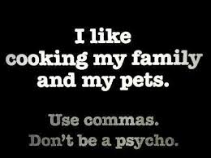
Using punctuation for effect…

